Slide 1
Somerset Domestic Abuse Service
September 2023

Slide 2
Project aim
The research aimed to understand the needs and requirements of our users to inform our approach to user-centred design. Through researching with users (particularly in this very sensitive context), we can create a solution that is focused on their needs to ensure an effective digital front-door to the service.
The Domestic Abuse project set out to find out how people in Somerset currently access support services for Domestic Abuse, their priority needs and aspects of accessing support that they have found difficult. We wanted to know what works well for those accessing information and support and how this could potentially be improved.
Domestic Abuse can affect anyone of any age. We wanted to know if the needs of each demographic are met and if users recognise that Domestic Abuse services are for them and feel able to access them. We also wanted to find out the experiences of those referring or signposting, what tools and resources they would find most helpful to ensure that those affected can get the help they need.
The purpose of the research was to identify how we might achieve the following vision:
Provide a clear route for people affected by domestic abuse and professionals to understand and access support services.

Slide 3
Goals
Test user journeys on the new Domestic Abuse website to identify problems.
Uncover opportunities to improve
Learn more about target user’s behaviours and preferences
1
2
3
What?
Usability testing:
Finding information on unhealthy relationships and domestic abuse.
Accessing help in urgency – contact information, about the service, what will happen if I get in touch
Accessing helpful information as well as additional support services
Making a referral
Finding information for professionals – supporting and signposting someone
Finding information on referring perpetrators
How?
Moderated usability testing was conducted and recorded via video call. Sessions lasted for 45- 60 minutes and included a brief interview and 3 practical journey tasks.
Participants gave written consent in advance for their data to be used as part of the study
Who?
Usability testing was conducted with 5 people affected by domestic abuse and 4 professionals
Participants included those who had previously been interviewed as well as the Councils Customer Panel
Participants included a range of users
Testing was conducted mainly on desktop but also included mobile

Slide 4
Participants
5 People affected by domestic abuse
4 Professionals

Slide 5
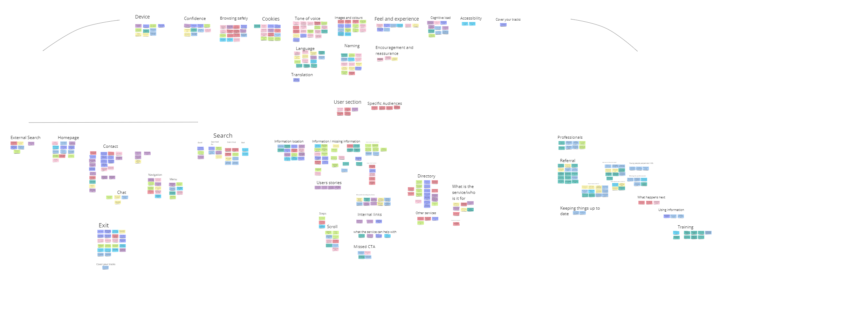
Affinity Map (See Miro)

Slide 6
User Journey Maps (See Miro)

